Slide 1
Usb 2.0 specs
Investigation report
September 5,
The Nguyen, bao nguyen
Ra fsp group,
Renesas Electronics Corporation

Slide 2
Agenda
Architecture overview Page 03
USB data flow model Page 07
Electrical signaling Page 11
Protocol layer Page 17
Packet field format Page 19
Packet format Page 25
Transactions Page 35
Data Toggle Synchronization Page 43
Error Detection Page 47

Slide 3
Architectural Overview

Slide 4
Architectural Overview USB System Description
A USB system is described by three definitional areas:
USB interconnect: is the manner in which USB devices are connected to and communicate with the host. This includes the following:
Bus Topology
Inter-layer Relationships
Data Flow Models
USB Schedule
USB devices: are one of the following
Hubs: which provide additional attachment points to the USB
Functions: which provide capabilities to the system, such as an ISDN connection, a digital joystick, or speakers
USB host: only 1 host in an USB system

Slide 5
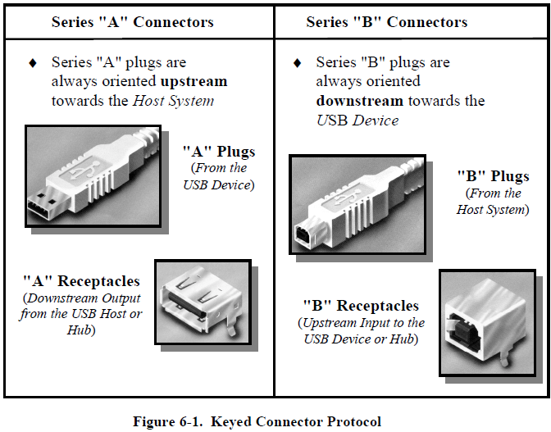
Architectural Overview Physical Interface: Mechanical
There are 2 type of Keyed Connector Protocol for USB 2.0:
Series "A" Connectors
Series "B" Connectors

Slide 6
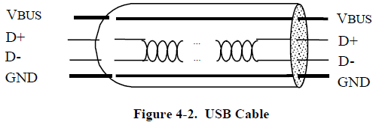
Architectural Overview Physical Interface: Electrical
The USB transfers signal and power over a four-wire cable.
The signaling occurs over two wires on each point-to-point segment.
There are three data rates:
The USB high-speed signaling bit rate is 480 Mb/s.
The USB full-speed signaling bit rate is 12 Mb/s.
A limited capability low-speed signaling mode is also defined at 1.5 Mb/s

Slide 7
USB Data Flow Model

Slide 8
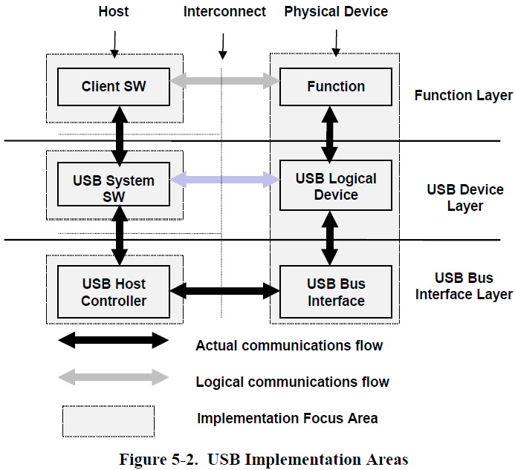
USB Data Flow Model Implementer Viewpoints
In particular, there are four focus implementation areas:
USB Physical Device: A piece of hardware on the end of a USB cable that performs some useful end user function.
Client Software: Software that executes on the host, corresponding to a USB device. This client software is typically supplied with the operating system or provided along with the USB device.
USB System Software: Software that supports the USB in a particular operating system. The USB System Software is typically supplied with the operating system, independently of particular USB devices or client software.
USB Host Controller (Host Side Bus Interface): The hardware and software that allows USB devices to be attached to a host.

Slide 9
USB Data Flow Model Physical Interface
The USB host interacts with USB devices through the Host Controller. The host is responsible for the following:
Detecting the attachment and removal of USB devices
Managing control flow between the host and USB devices
Collecting status and activity statistics
Providing power to attached USB devices
USB physical devices provide additional functionality to the host and present the same basic interface to the host. A USB physical device’s logical composition includes the following:
USB bus interface
USB logical device
Function

Slide 10
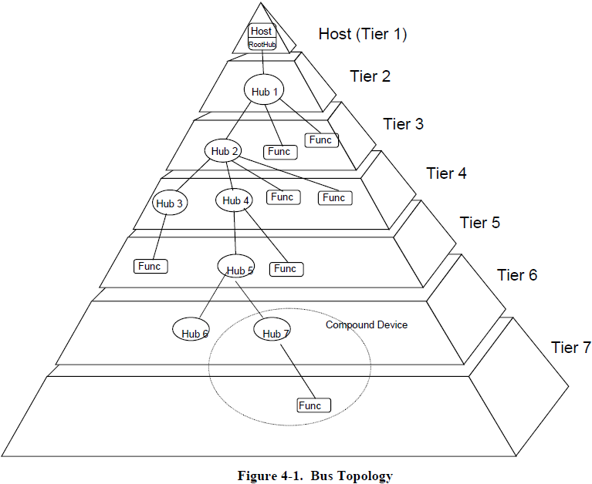
USB Data Flow Model Physical Bus Topology
The USB connects USB devices with the USB host with physical interconnect is a tiered star topology.
A hub is at the center of each star
Each wire segment is a point-to-point connection between the host and a hub or function, or a hub connected to another hub or function
The maximum number of tiers allowed is seven (including the root tier).
In seven tiers, five non-root hubs maximum can be supported in a communication path between the host and any device
A compound device occupies two tiers; therefore, it cannot be enabled if attached at tier level seven.

Slide 11
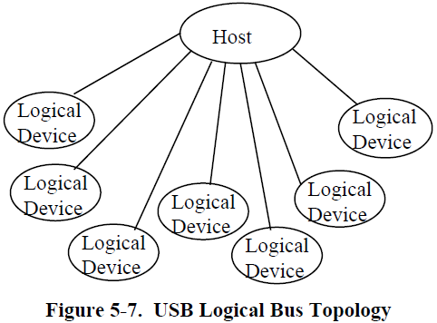
USB Data Flow Model Logical Bus Topology
While devices physically attach to the USB in a tiered, star topology, the host communicates with each logical device as if it were directly connected to the root port.
Even though most host/logical device activities use this logical perspective, the host maintains an awareness of the physical topology to support processing the removal of hubs.

Slide 12
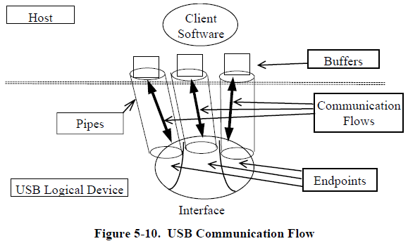
USB Data Flow Model USB Communication Flow
A USB logical device appears to the USB system as a collection of endpoints grouped into endpoint sets that implement an interface.
The USB System Software manages the device using the Default Control Pipe.
Client software manages an interface using pipe bundles (associated with an endpoint set).
Client software requests that data be moved across the USB between a buffer on the host and an endpoint on the USB device.
The Host Controller (or USB device, depending on transfer direction) packetizes the data to move it over the USB.
Software on the host communicates with a logical device via a set of communication flows.

Slide 13
USB Data Flow Model Device Endpoints
Each USB device has a number of endpoints. Each endpoint is a source or sink of data:
Each endpoint on a device is given at design time a unique device-determined identifier called the endpoint number.
Endpoint Zero:
Used to initialize and generically manipulate the logical device
The endpoints with endpoint number zero are always accessible once a device is attached, powered, and has received a bus reset.
Non-endpoint Zero:
Additional endpoints required for function’s implementation.
Cannot be used until the device is configured.

Slide 14
USB Data Flow Model Pipes
A USB pipe is an association between an endpoint on a device and software on the host, represent the ability to move data between software on the host via a memory buffer and an endpoint on a device:
Stream Pipe: Data moving through a pipe has no USB-defined structure
Message Pipe: Data moving through a pipe has some USB-defined structure
Default Control Pipe: The pipe that consists of the two endpoints with endpoint number zero

Slide 15
Signaling

Slide 16
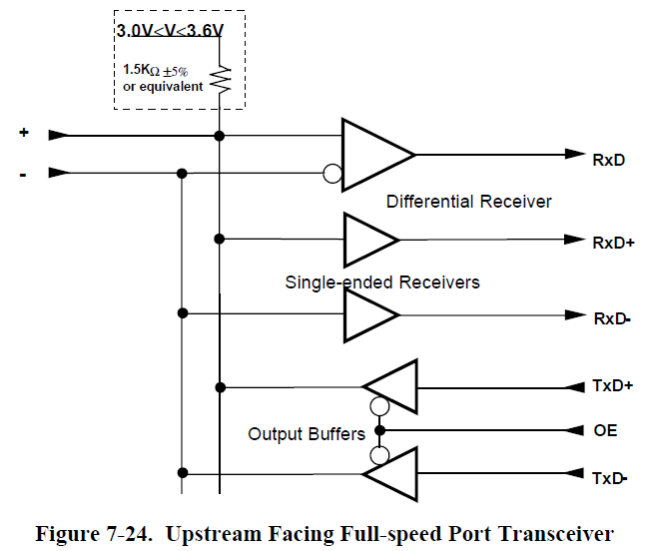
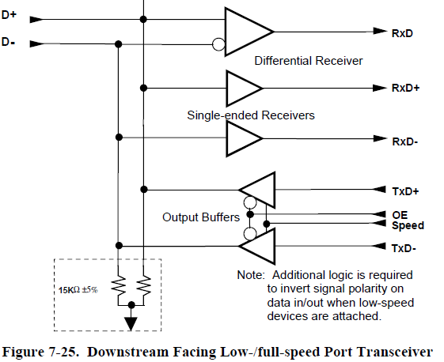
Signaling Transceiver Circuit

Slide 17
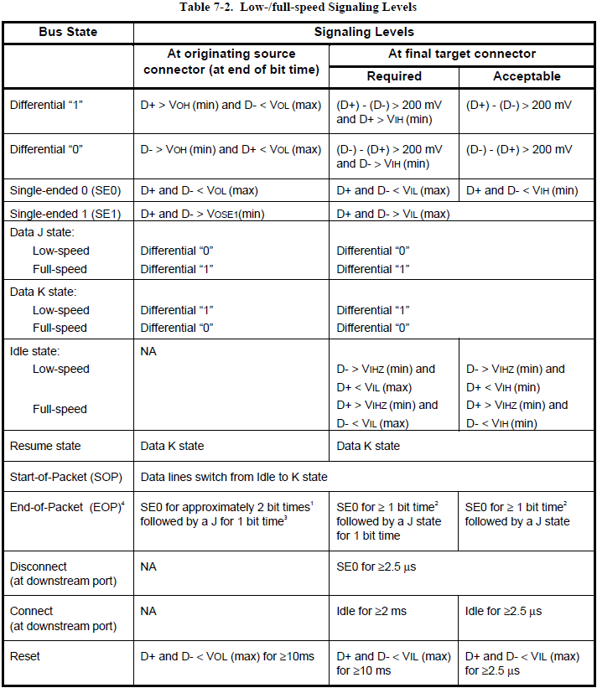
Signaling Signaling Levels
Table 7-2 summarizes the USB Low-/full-speed Signaling Levels. The source is required to drive the levels specified in the second column, and the target is required to identify the correct bus state when it sees the levels in the third column. (Target receivers can be more sensitive as long as they are within limits specified in the fourth column.)

Slide 18
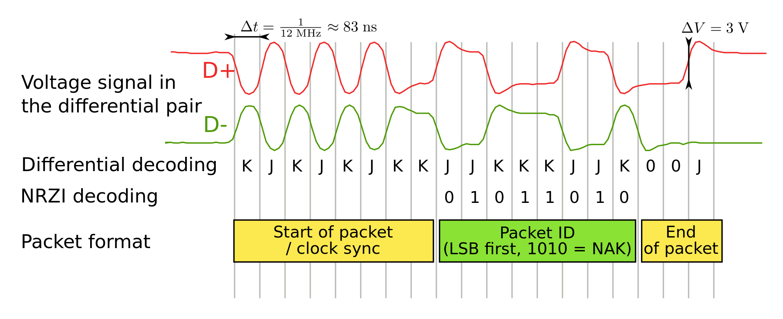
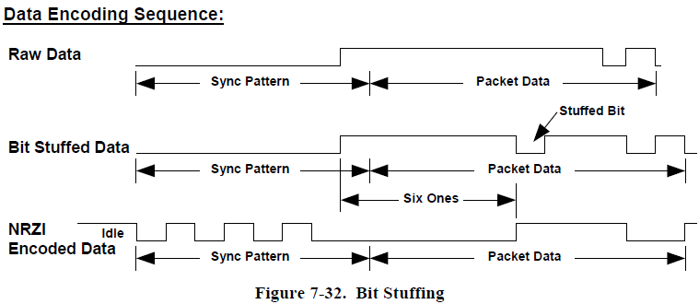
Signaling transmission
USB data is transmitted by toggling the data lines between the J state and the opposite K state:
0 bit is transmitted by toggling the data lines from J to K or vice versa.
1 bit is transmitted by leaving the data lines as-is.
To ensure that there are enough signal transitions for clock recovery to occur in the bitstream, a bit stuffing technique is applied to the data stream: an extra 0 bit is inserted into the data stream after any occurrence of six consecutive 1 bits.

Slide 19
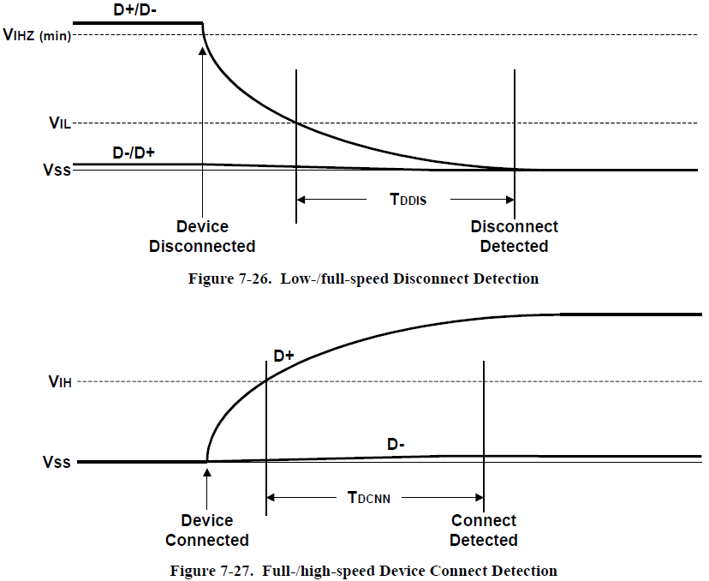
Signaling Connect and Disconnect Signaling
When no function is attached to the downstream facing port of a host or hub in low-/full-speed:
Both D+ and D- to be pulled below the single-ended low threshold of the host or hub transceiver when that port is not being driven by the hub.
An SE0 state created on the downstream facing port.
A disconnect condition is indicated if the host or hub is not driving the data lines and an SE0 persists on a downstream facing port for more than TDDIS.
A connect condition will be detected when the hub detects that one of the data lines is pulled above its VIH threshold for more than TDCNN.

Slide 20
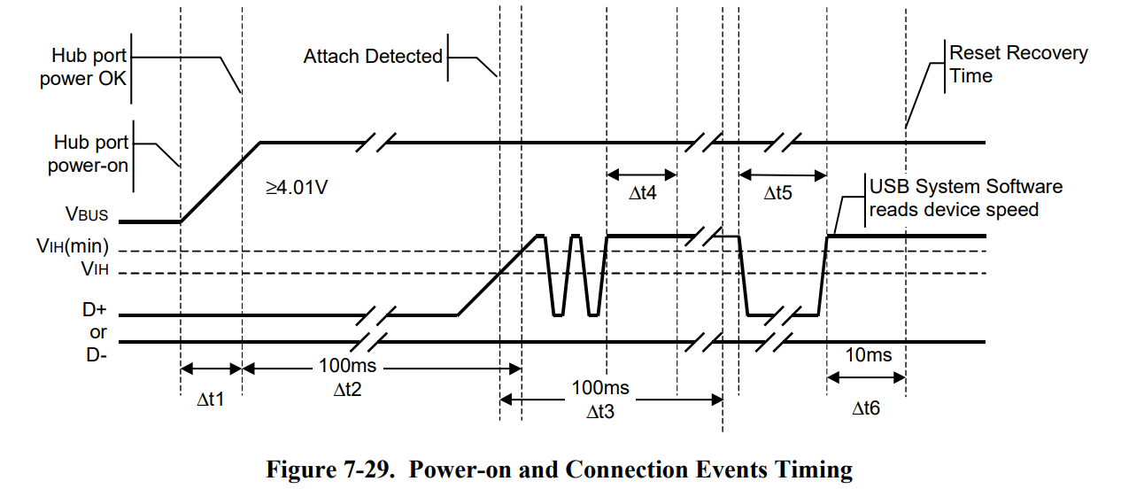
Signaling Detecting USB connection
Because USB components may be hot plugged, and hubs may implement power switching, it is necessary to comprehend the delays between power switching and/or device attach and when the device’s internal power has stabilized.
Figure 7-29 shows all the events associated with both turning on port power with a device connected and hot-plugging a device. There are six delays and a sequence of events that are defined by this specification.

Slide 21
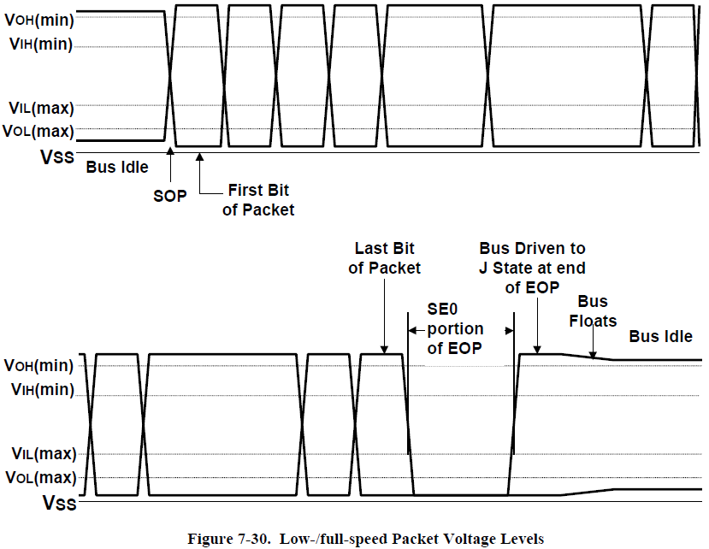
Signaling Data Signaling
The start of a packet (SOP) is signaled by the originating port by driving the D+ and D- lines from the Idle state to the opposite logic level (K state).
The SE0 state is used to signal an end-of-packet (EOP). EOP will be signaled by driving D+ and D- to the SE0 state for two bit times followed by driving the lines to the J state for one bit time. The J state is asserted for one bit time and then both the D+ and D- output drivers are placed in their high-impedance state. The bus termination resistors hold the bus in the Idle state.

Slide 22
Protocol Layer

Slide 23
Protocol Layer Packet Formats
Byte/Bit Ordering:
Bits are sent out onto the bus least-significant bit (LSb) first, through to the most-significant bit (MSb) last.
Multiple byte fields in standard descriptors, requests, and responses are interpreted as and moved over the bus in little-endian order, i.e., LSB to MSB.
SYNC Field:
All packets begin with a synchronization (SYNC) field, which is a coded sequence that generates a maximum edge transition density.
A SYNC from an initial transmitter is defined to be eight bits in length for full/low-speed and 32 bits for high-speed.
The last two bits in the SYNC field are a marker that is used to identify the end of the SYNC field and, by inference, the start of the PID.

Slide 24
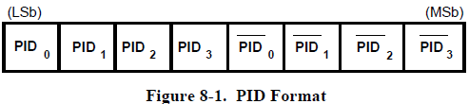
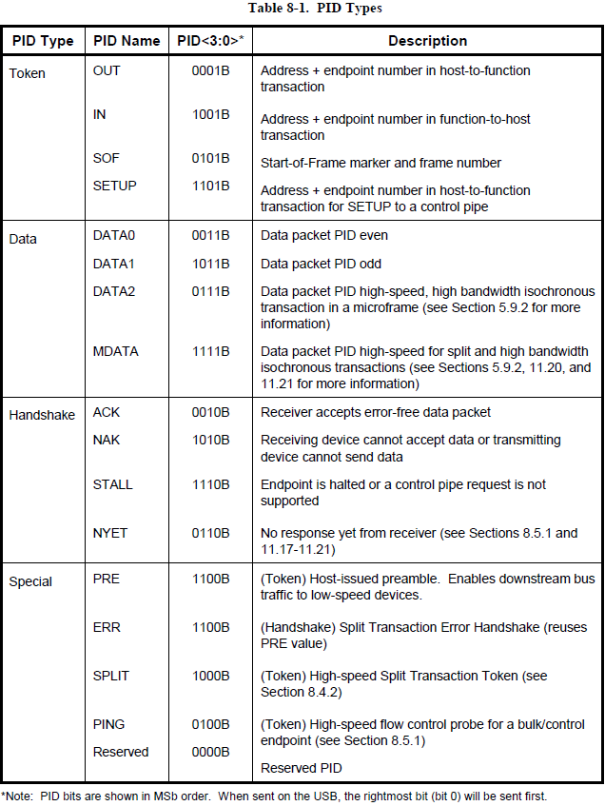
Protocol Layer Packet Field Formats: Packet Identifier Field
A packet identifier (PID) immediately follows the SYNC field of every USB packet:
A PID consists of a four-bit packet type field followed by a four-bit check field
The PID indicates the type of packet and, by inference, the format of the packet and the type of error detection applied to the packet.
A PID error exists if the four PID check bits are not complements of their respective packet identifier bits.
Any PID received with a failed check field or which decodes to a non-defined value is assumed to be corrupted and it, as well as the remainder of the packet, is ignored by the packet receiver.
If a function receives an otherwise valid PID for a transaction type or direction that it does not support, the function must not respond.

Slide 25
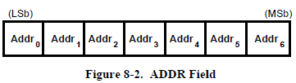
Protocol Layer Packet Field Formats: Address Field
The function address (ADDR) field specifies the function, via its address, that is either the source or destination of a data packet, depending on the value of the token PID:
As shown in Figure 8-2, a total of 128 addresses are specified as ADDR<6:0>
The ADDR field is specified for IN, SETUP, and OUT tokens and the PING and SPLIT special token
By definition, each ADDR value defines a single function
Upon reset and power-up, a function’s address defaults to a value of zero and must be programmed by the host during the enumeration process
Function address zero is reserved as the default address and may not be assigned to any other use.

Slide 26
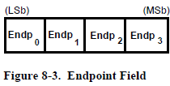
Protocol Layer Packet Field Formats: Endpoint Field
An additional four-bit endpoint (ENDP) field, shown in Figure 8-3, permits more flexible addressing of functions in which more than one endpoint is required:
Except for endpoint address zero, endpoint numbers are function-specific
The endpoint field is defined for IN, SETUP, and OUT tokens and the PING special token
All functions must support a control pipe at endpoint number zero (the Default Control Pipe). Full-speed and high-speed functions may support up to a maximum of 16 IN and OUT endpoints

Slide 27
Protocol Layer Packet Field Formats: Frame Number Field
The frame number field is an 11-bit field that is incremented by the host on a per-frame basis. The frame number field rolls over upon reaching its maximum value of 7FFH and is sent only in SOF tokens at the start of each (micro)frame.

Slide 28
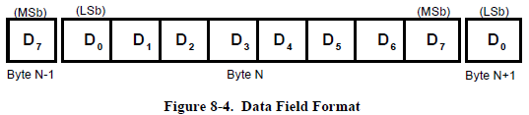
Protocol Layer Packet Field Formats: Data Field
The data field may range from zero to 1,024 bytes and must be an integral number of bytes. Figure 8-4 shows the format for multiple bytes. Data bits within each byte are shifted out LSb first.

Slide 29
Protocol Layer Packet Field Formats: Cyclic Redundancy Checks
Cyclic redundancy checks (CRCs) are used to protect all non-PID fields in token and data packets:
All CRCs are generated over their respective fields in the transmitter before bit stuffing is performed. Similarly, CRCs are decoded in the receiver after stuffed bits have been removed.
A CRC error exists if the computed checksum remainder at the end of a packet reception does not match the residual.
Bit stuffing requirements must be met for the CRC, and this includes the need to insert a zero at the end of a CRC if the preceding six bits were all ones.

Slide 30
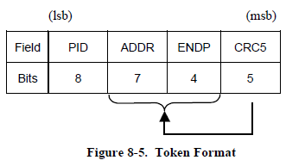
Protocol Layer Packet Formats: Token Packets
A token consists of a PID, specifying either IN, OUT, or SETUP packet type and ADDR and ENDP fields:
For OUT and SETUP transactions, the address and endpoint fields uniquely identify the endpoint that will receive the subsequent Data packet.
For IN transactions, these fields uniquely identify which endpoint should transmit a Data packet.
For PING transactions, these fields uniquely identify which endpoint will respond with a handshake packet.
Only the host can issue token packets.
An IN PID defines a Data transaction from a function to the host.
OUT and SETUP PIDs define Data transactions from the host to a function.
A PING PID defines a handshake transaction from the function to the host.
Token and SOF packets are delimited by an EOP after three bytes of packet field data.

Slide 31
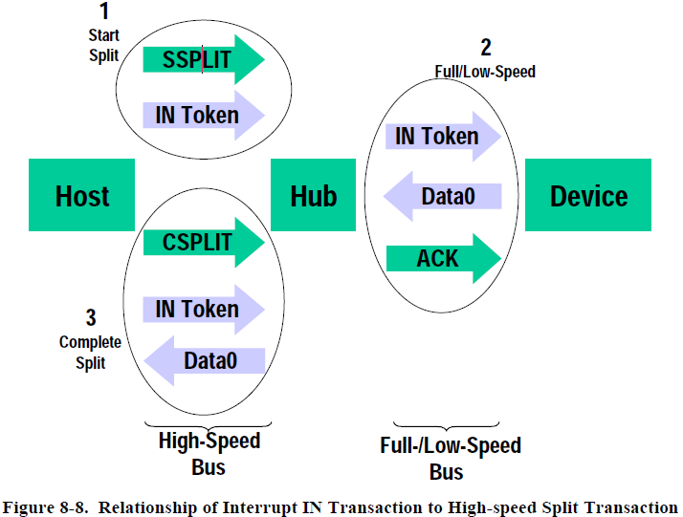
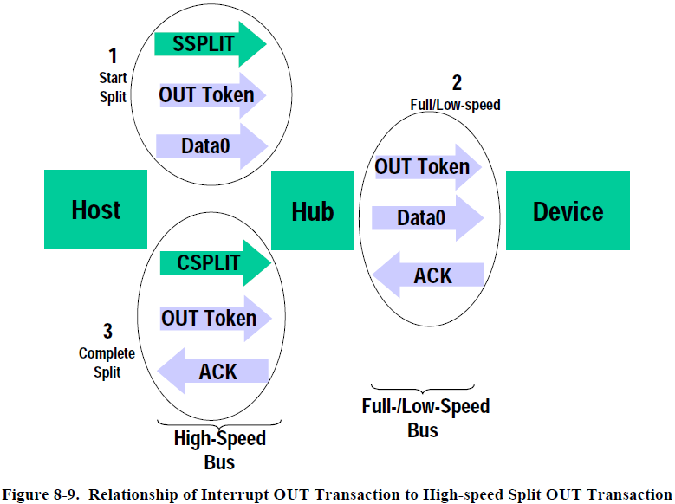
Protocol Layer Packet Formats: Split Transactions
USB defines a special token for split transactions: SPLIT. This is a 4 byte token packet compared to other normal 3 byte token packets.
A high-speed split transaction is used only between the host controller and a hub when the hub has full-/low-speed devices attached to it. A high-speed split transaction has two parts: a start-split and a complete-split

Slide 32
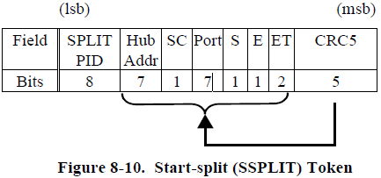
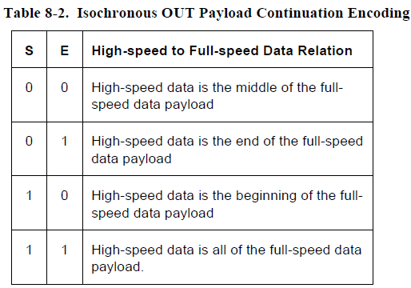
Protocol Layer Packet Formats: Start-Split Transaction Token
The Hub addr field contains the USB device address of the hub supporting the specified full-/low-speed device for this full-/low-speed transaction. This field has the same definition as the ADDR field definition
SC (Start/Complete) field set to zero indicates that this is a start-split transaction (SSPLIT)
The Port field contains the port number of the target hub for which this full-/low-speed transaction is destined
The S (Speed) field specifies the speed for this interrupt or control transaction as follows: 0 – Full speed; 1 – Low speed
For bulk IN/OUT and isochronous IN start-splits, the S field must be set to zero. For bulk/control IN/OUT, interrupt IN/OUT, and isochronous IN start-splits, the E field must be set to zero.
For full-speed isochronous OUT start-splits, the S1 (Start) and E (End) fields specify how the high-speed data payload corresponds to data for a full-speed data packet as shown in Table 8-2.

Slide 33
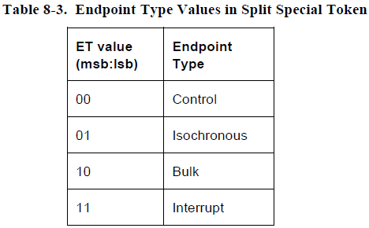
Protocol Layer Packet Formats: Start-Split Transaction Token
The ET (Endpoint Type) field specifies the endpoint type of the full-/low-speed transaction as shown in Table 8-3.

Slide 34
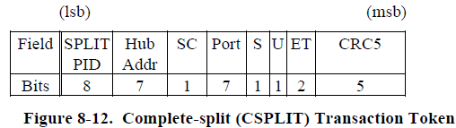
Protocol Layer Packet Formats: Complete-Split Transaction Token
A SPLIT special token packet with the SC field set to one indicates that this is a complete-split transaction (CSPLIT).
The U bit is reserved/unused and must be reset to zero(0B).
The other fields of the complete-split token packet have the same definitions as for the start-split token packet.

Slide 35
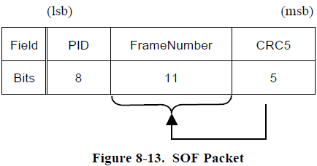
Protocol Layer Packet Formats: Start-of-Frame Packets
Start-of-Frame (SOF) packets are issued by the host at a nominal rate of once every 1.00 ms ±0.0005 ms for a full-speed bus and 125 μs ±0.0625 μs for a high-speed bus. SOF packets consist of a PID indicating packet type followed by an 11-bit frame number field as illustrated in Figure 8-13.
Frame timing sensitive functions, that do not need to keep track of frame number (e.g., a full-speed operating hub), need only decode the SOF PID; they can ignore the frame number and its CRC.
If a function needs to track frame number, it must comprehend both the PID and the time stamp.
Full-speed devices that have no particular need for bus timing information may ignore the SOF packet.

Slide 36
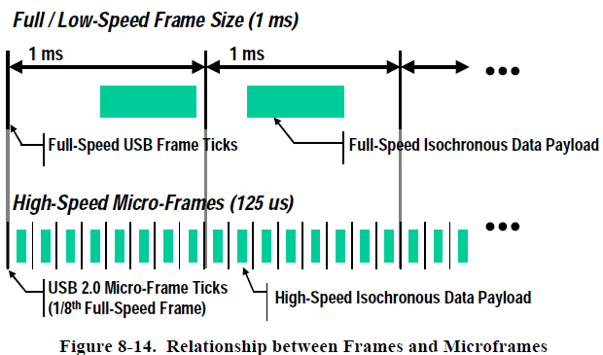
Protocol Layer Packet Formats: USB Frames and Microframes
USB defines a full-speed 1 ms frame time indicated by a Start Of Frame (SOF) packet each and every 1ms period with defined jitter tolerances.
USB also defines a high-speed microframe with a 125 μs frame time with related jitter tolerances (See Chapter 7).
SOF packets are generated (by the host controller or hub transaction translator) every 1ms for full-speed links.
SOF packets are also generated after the next seven 125 μs periods for high-speed links.
High-speed devices see an SOF packet with the same frame number eight times (every 125 μs) during each 1 ms period.
If desired, a high-speed device can locally determine a particular microframe “number” by detecting the SOF that had a different frame number than the previous SOF and treating that as the zeroth microframe. The next seven SOFs with the same frame number can be treated as microframes 1 through 7.

Slide 37
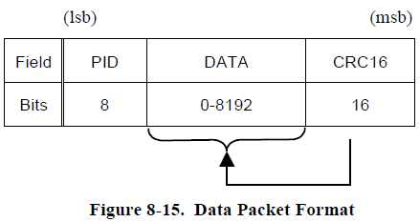
Protocol Layer Packet Formats: Data Packets
A data packet consists of a PID, a data field containing zero or more bytes of data, and a CRC as shown in Figure 8-15:
There are four types of data packets, identified by differing PIDs: DATA0, DATA1, DATA2 and MDATA.
Data must always be sent in integral numbers of bytes. The data CRC is computed over only the data field in the packet and does not include the PID, which has its own check field.
The maximum data payload size allowed for low-speed devices is 8 bytes. The maximum data payload size for full-speed devices is 1023. The maximum data payload size for high-speed devices is 1024 bytes.

Slide 38
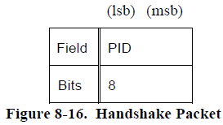
Protocol Layer Packet Formats: Handshake Packets
Handshake packets consist of only a PID, used to report the status of a data transaction and can return values indicating successful reception of data, command acceptance or rejection, flow control, and halt conditions, delimited by an EOP after one byte of packet field.
ACK indicates that the data packet was received without bit stuff or CRC errors over the data field and that the data PID was received correctly
NAK indicates that a function was unable to accept data from the host (OUT) or that a function has no data to transmit to the host (IN).
STALL is returned by a function in response to an IN token or after the data phase of an OUT or in response to a PING transaction, indicates that a function is unable to transmit or receive data, or that a control pipe request is not supported.
NYET returned by a highspeed endpoint as part of the PING protocol or returned by a hub in response to a split-transaction when the full-/low-speed transaction has not yet been completed or the hub is otherwise not able to handle the split-transaction
ERR is a high-speed only handshake that is returned to allow a high-speed hub to report an error on a full-/low-speed bus.

Slide 39
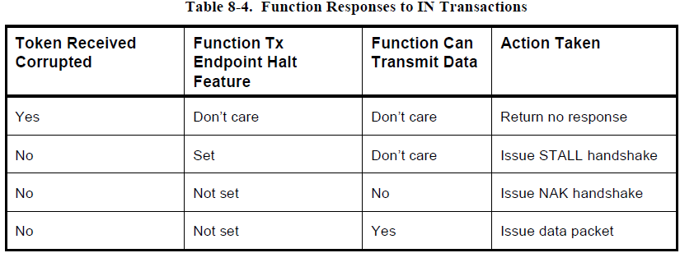
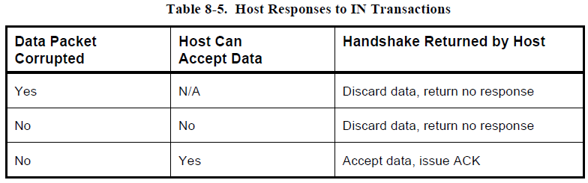
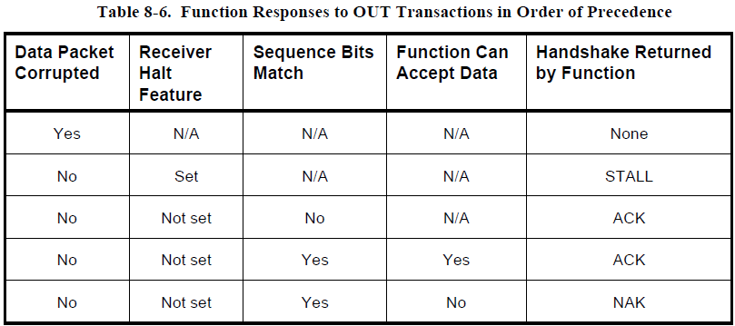
Protocol Layer Packet Formats: Handshake Responses
Transmitting and receiving functions must return handshakes based upon an order of precedence detailed in Table 8-4 through Table 8-6.

Slide 40
Protocol Layer Packet Formats: Transactions
Each transfer type determines various characteristics of the communication flow including the following:
Data format imposed by the USB
Direction of communication flow
Packet size constraints vBus access constraints
Latency constraints
Required data sequences
Error handling

Slide 41
Protocol Layer Packet Formats: Transactions
Bulk Transactions
Data type: typically consists of larger amounts of data (printers or scanners)
Reliable: guaranteed with error detection & retry mechanism
Bandwidth requirements: high
Isochronous Transactions
Data type: continuous and real-time data (audio or video)
Reliable: not guaranteed
Bandwidth requirements: low
Interrupt Transactions
Data type: limited-latency transfer to or from a device
Reliable: guaranteed with error detection
Requirement: limited-latency
Control Transactions
Data type: configuration data for device when they are first attached
Reliable: guaranteed with data delivery is lossless

Slide 42
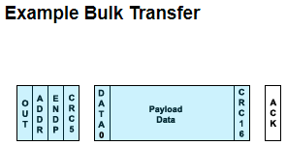

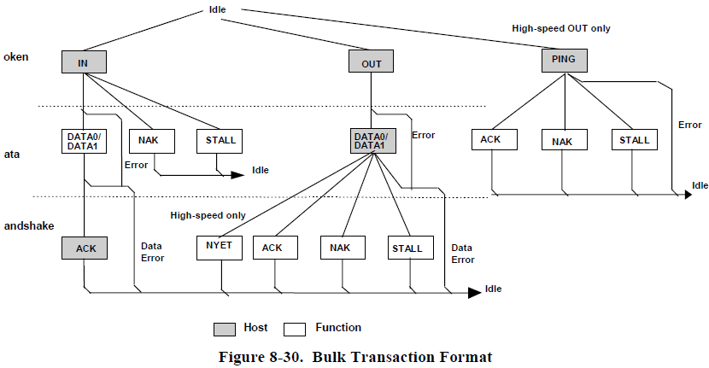
Protocol Layer Packet Formats: Bulk IN Transaction
Bulk IN Transaction flow:
When the host is ready to receive bulk data, it issues an IN token
The function endpoint responds by returning either a data packet or, should it be unable to return data, a NAK or STALL handshake.
If the host receives a valid data packet, it responds with an ACK handshake.
If the host detects an error while receiving data, it returns no handshake packet to the function

Slide 43
Protocol Layer Packet Formats: Bulk OUT Transaction
Bulk OUT Transaction flow:
When the host is ready to transmit bulk data, it first issues an OUT token packet followed by a data packet (or PING special token packet)
If the data is received without error by the function, it will return:
ACK indicates that the data packet was received without errors , host may send the next packet in the sequence.
NAK indicates that the function was in a temporary condition preventing it from accepting the data, host should resend the data.
STALL indicates that the endpoint was halted, the host should not retry the transmission because there is an error condition on the function.
If the data packet was received with a CRC or bit stuff error, no handshake is returned.

Slide 44
Protocol Layer Bulk Transaction
Bulk Transfer Packet Size Constraints
The USB defines the allowable maximum bulk data payload sizes to be only 8, 16, 32, or 64 bytes for full-speed endpoints and 512 bytes for high-speed endpoints.
A low-speed device must not have bulk endpoints.
All Host Controllers are required to have support for 8-, 16-, 32-, and 64-byte maximum packet sizes for full-speed bulk endpoints and 512 bytes for high-speed bulk endpoints.
Bulk Transfer Data Sequences
Bulk transactions use data toggle bits that are toggled only upon successful transaction completion to preserve synchronization between transmitter and receiver when transactions are retried due to errors.
Bulk transactions are retried due to errors detected on the bus that affect a given transaction.

Slide 45
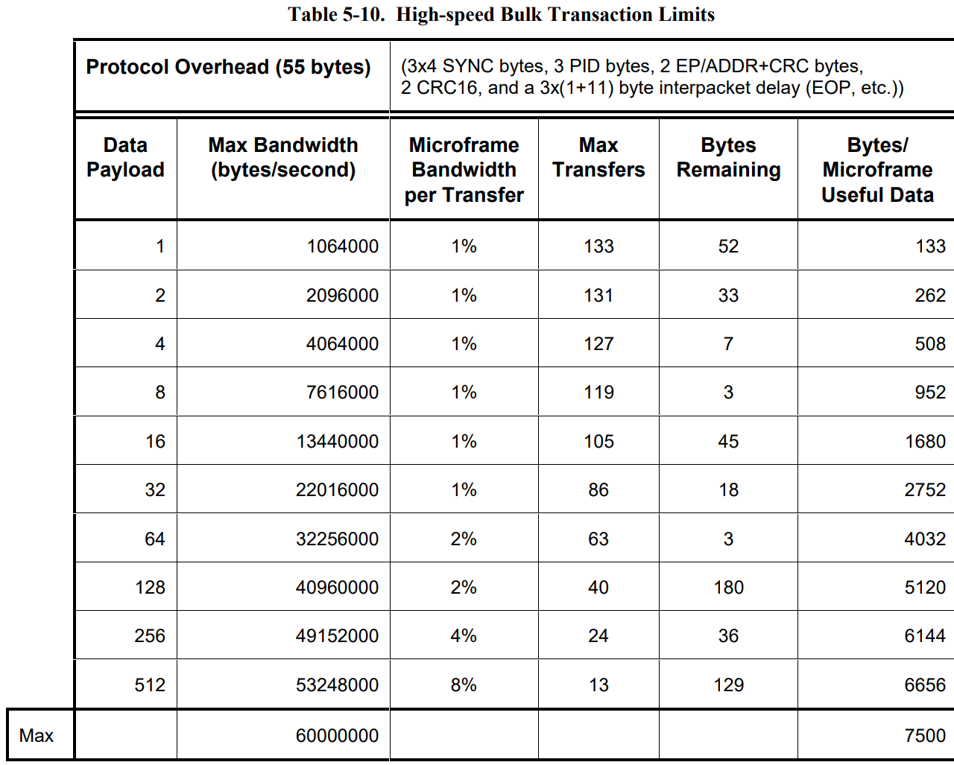
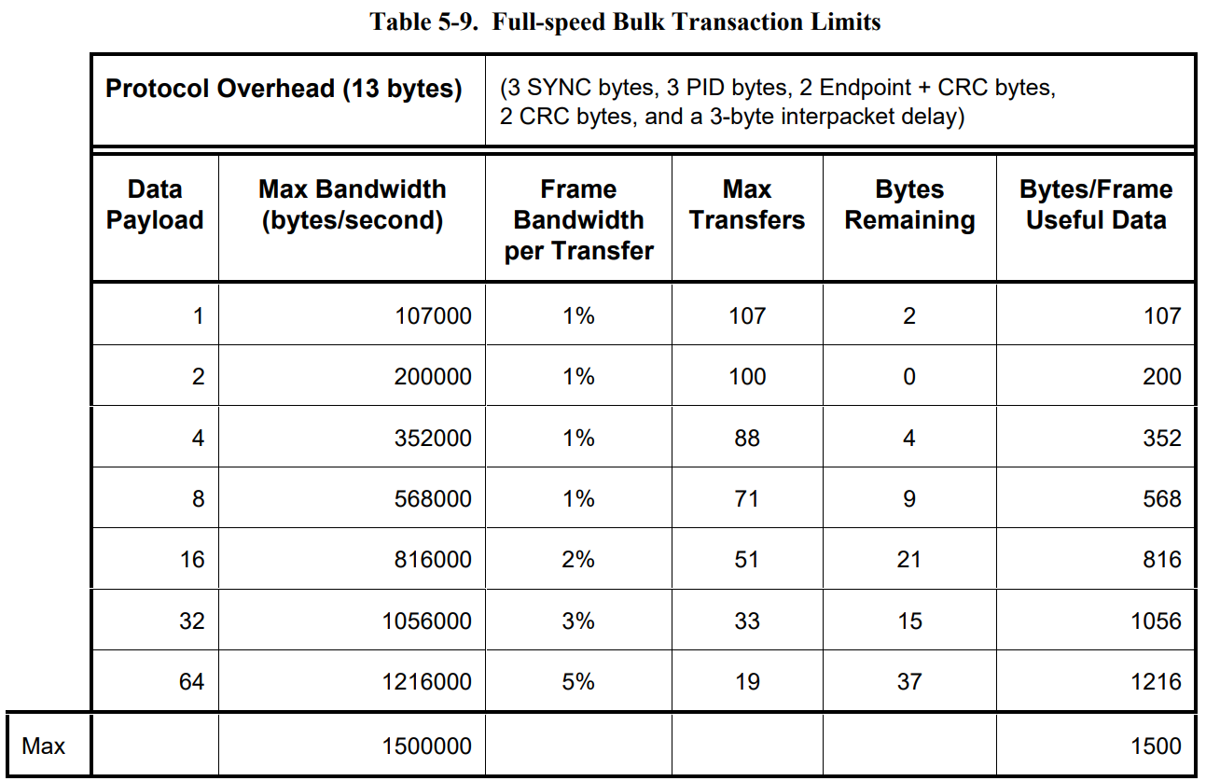
Protocol Layer Bulk Transaction
Bulk Transfer Bus Access Constraints
Only full-speed and high-speed devices can use bulk transfers.

Slide 46
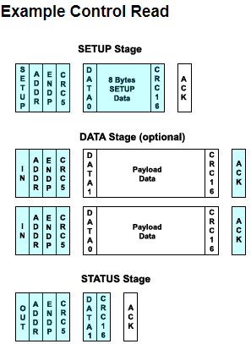
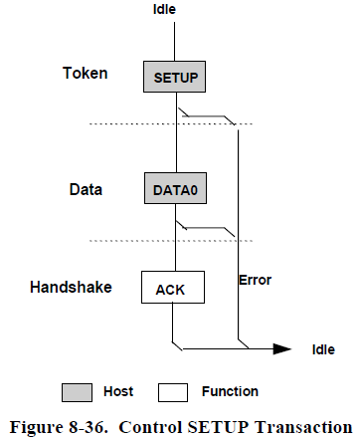
Protocol Layer Packet Formats: Control Transfers
Control transfers minimally have two transaction stages: Setup and Status (optionally contain a Data stage)
SETUP transaction is used to transmit information to the control endpoint of a function
A SETUP always uses a DATA0 PID for the data field of the SETUP transaction
The function receiving a SETUP must accept the SETUP data and respond with ACK
If the data is corrupted, discard the data and return no handshake

Slide 47
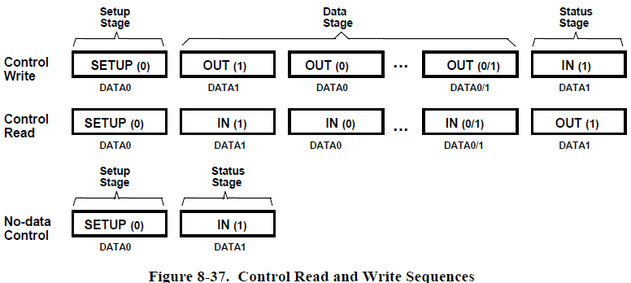
Protocol Layer Packet Formats: Control Transfers
Data stage :
Consists of one or more IN or OUT transactions and follows the same protocol rules as bulk transfers.
All the transactions must be in the same direction (all Ins/all OUTs) with amount of data direction are specified during the Setup stage.
If the data size exceeds the prenegotiated data packet size, it is sent in multiple transactions by the maximum packet size. Remaining is sent as a residual in the last transaction.
Status stage:
Delineated by a change in direction of data flow from the previous stage and always uses a DATA1 PID.
If the control sequence has no Data stage, then it consists of a Setup stage followed by a Status stage consisting of an IN transaction.

Slide 48
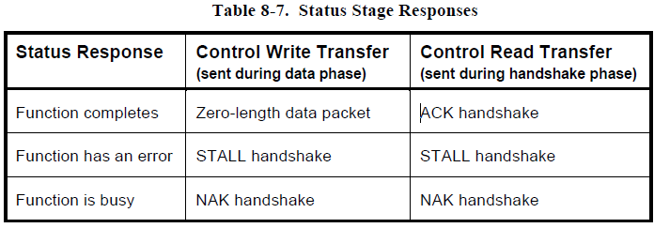
Protocol Layer Packet Formats: Control Transfers - Reporting Status Results
Table 8-7 summarizes the type of responses required for each:
Control write transfers return status information in the data phase of the Status stage transaction.
Control read transfers return status information in the handshake phase of a Status stage transaction, after the host has issued a zero-length data packet during the previous data phase.

Slide 49
Protocol Layer Packet Formats: Control Transfers
Control Transfer Packet Size Constraints
The allowable maximum control transfer data payload sizes for full-speed devices is 8, 16, 32, or 64 bytes; for high-speed devices, it is 64 bytes and for low-speed devices, it is 8 bytes.
An endpoint reports in its configuration information the value for its maximum data payload size. The USB does not require that data payloads transmitted be exactly the maximum size.
All Host Controllers are required to have support for 8-, 16-, 32-, and 64-byte maximum data payload sizes for full-speed control endpoints, only 8-byte maximum data payload sizes for low-speed control endpoints, and only 64-byte maximum data payload size for high-speed control endpoints.
When a Data stage is complete, the Host Controller advances to the Status stage instead of continuing on with another data transaction.

Slide 50
Protocol Layer Packet Formats: Control Transfers
Control Transfer Data Sequences
Control transfers require that a Setup bus transaction be sent from the host to a device to describe the type of control access that the device should perform. A Setup transaction should not normally be sent before the completion of a previous control transfer.
The USB provides robust error detection and recovery/retransmission for errors that occur during control transfers.

Slide 51
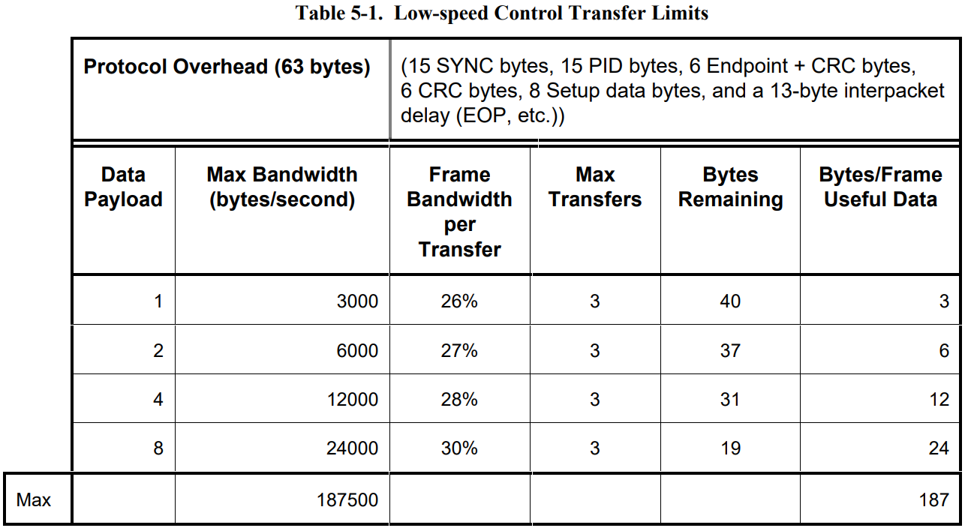
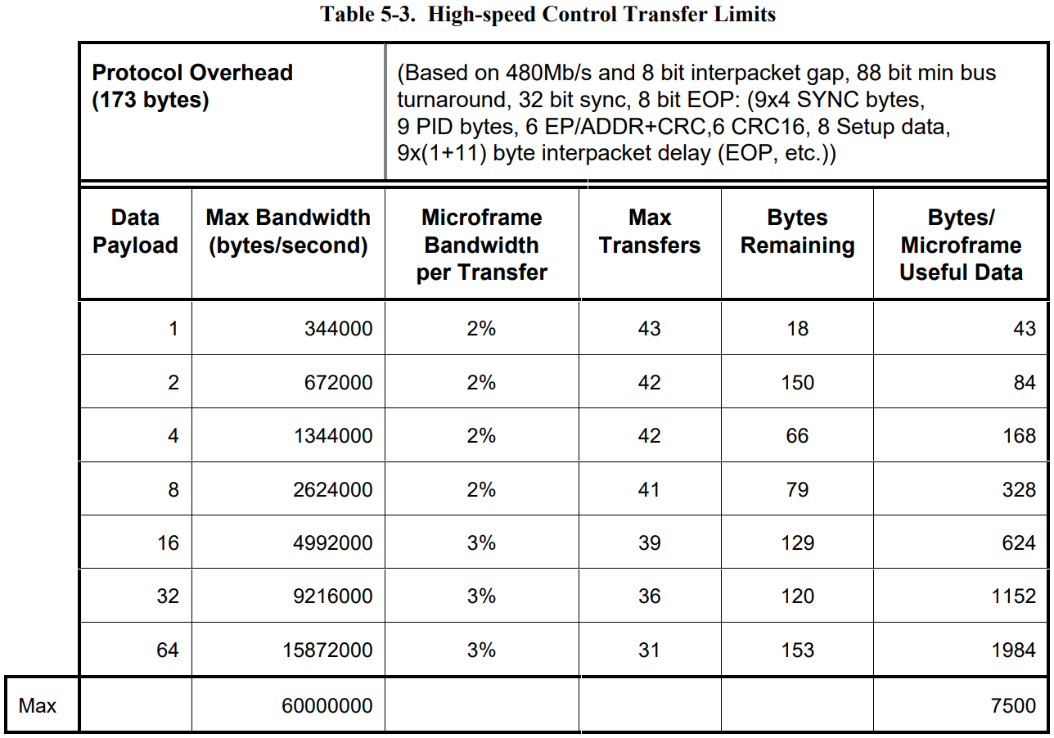
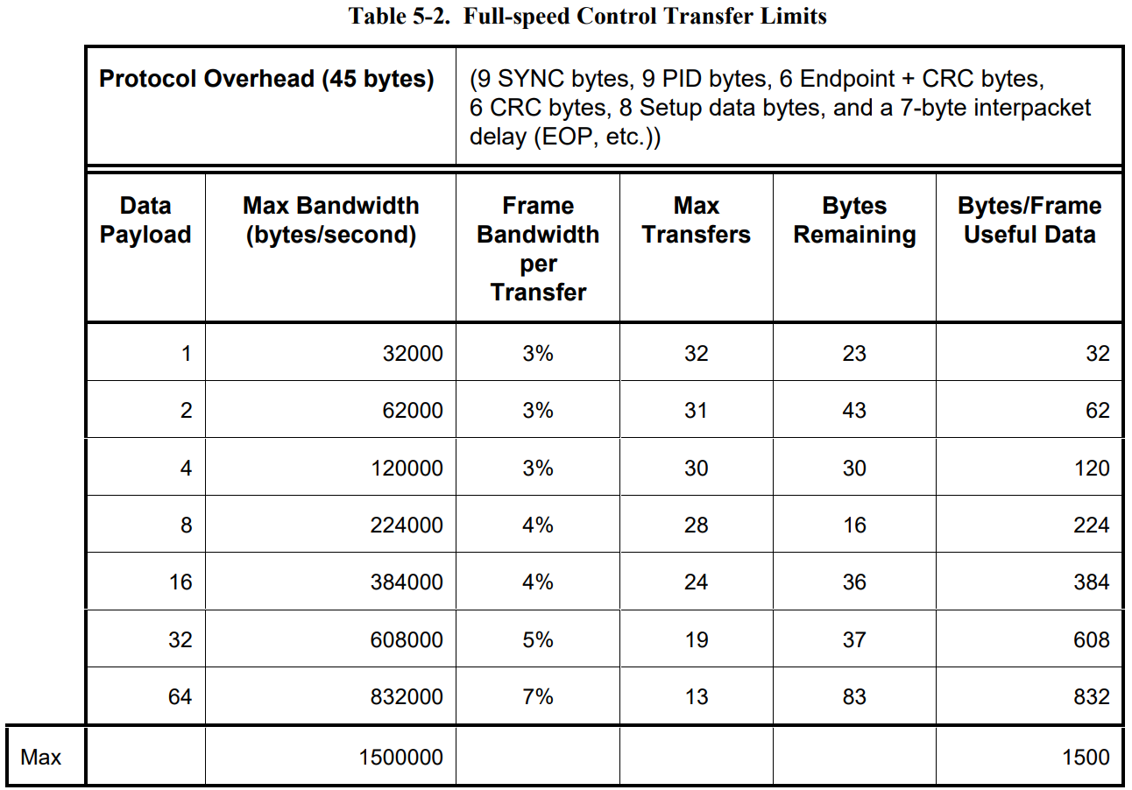
Protocol Layer Packet Formats: Control Transfers
Control Transfer Bus Access Constraints
Control transfers can be used by high-speed, full-speed, and low-speed USB devices.

Slide 52
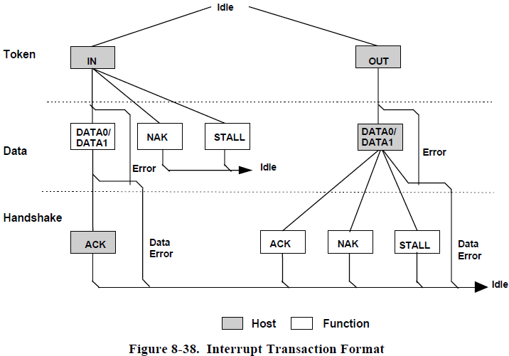
Protocol Layer Packet Formats: Interrupt Transactions
Interrupt transactions may consist of IN or OUT transfers:
A NAK return indicates that the endpoint has no new interrupt information to return
STALL return indicates that the Halt feature is set for the interrupt endpoint
If an interrupt is pending, the function returns the interrupt information as a data packet
The host, in response to receipt of the data packet, issues either an ACK handshake if data was received error-free or returns no handshake if the data packet was received corrupted

Slide 53
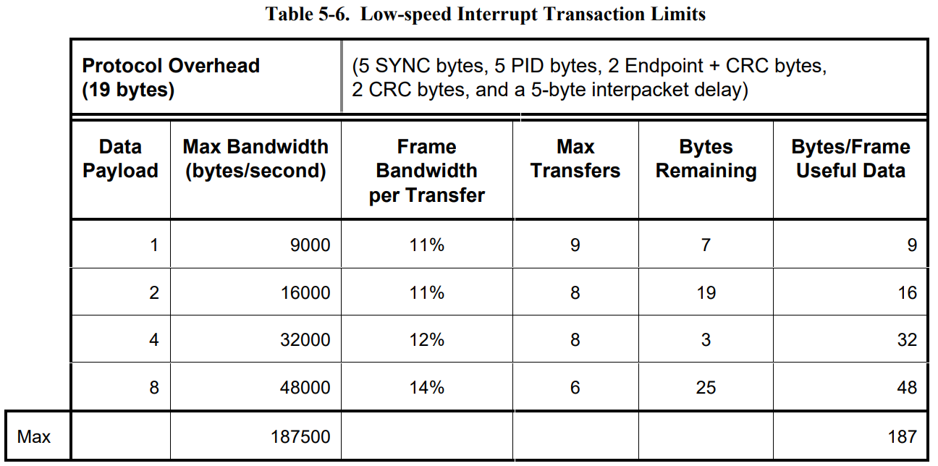
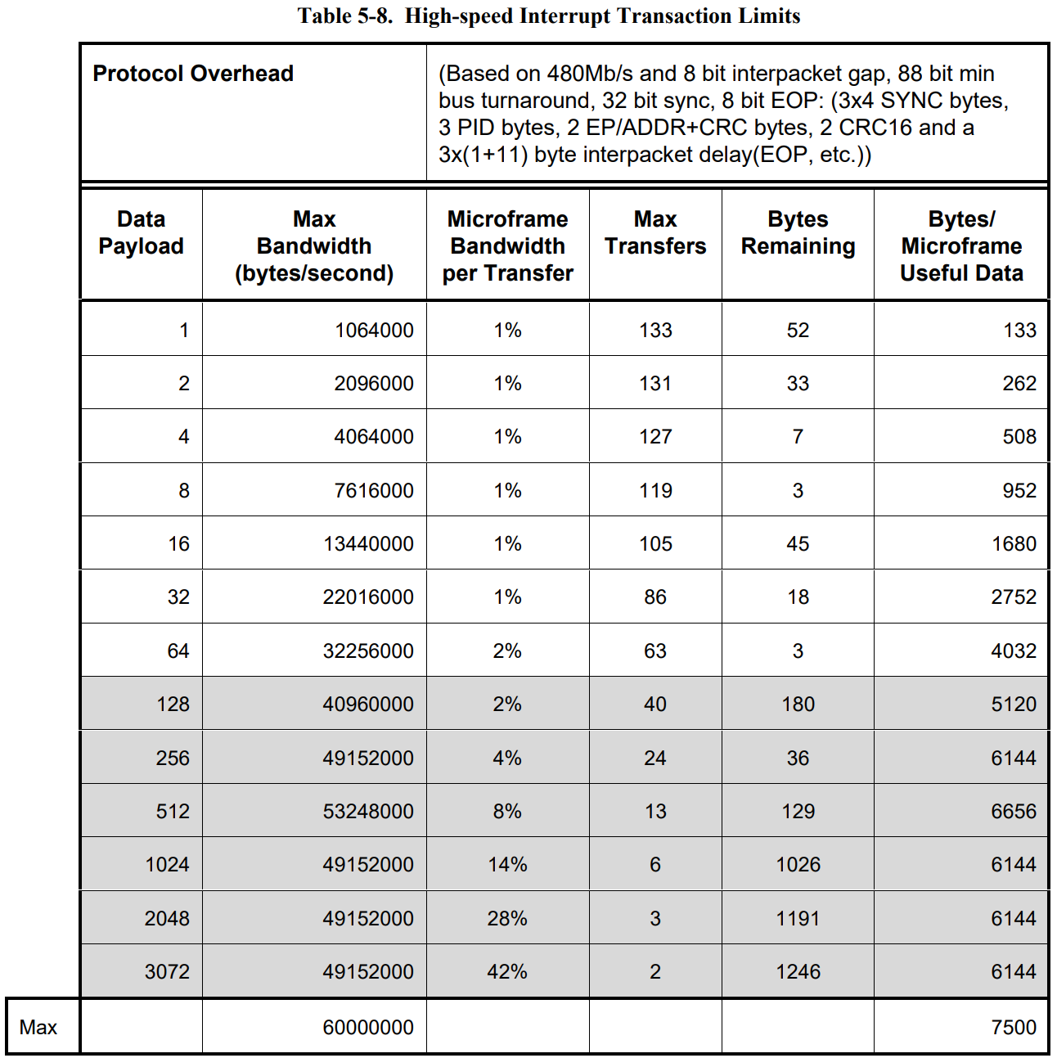
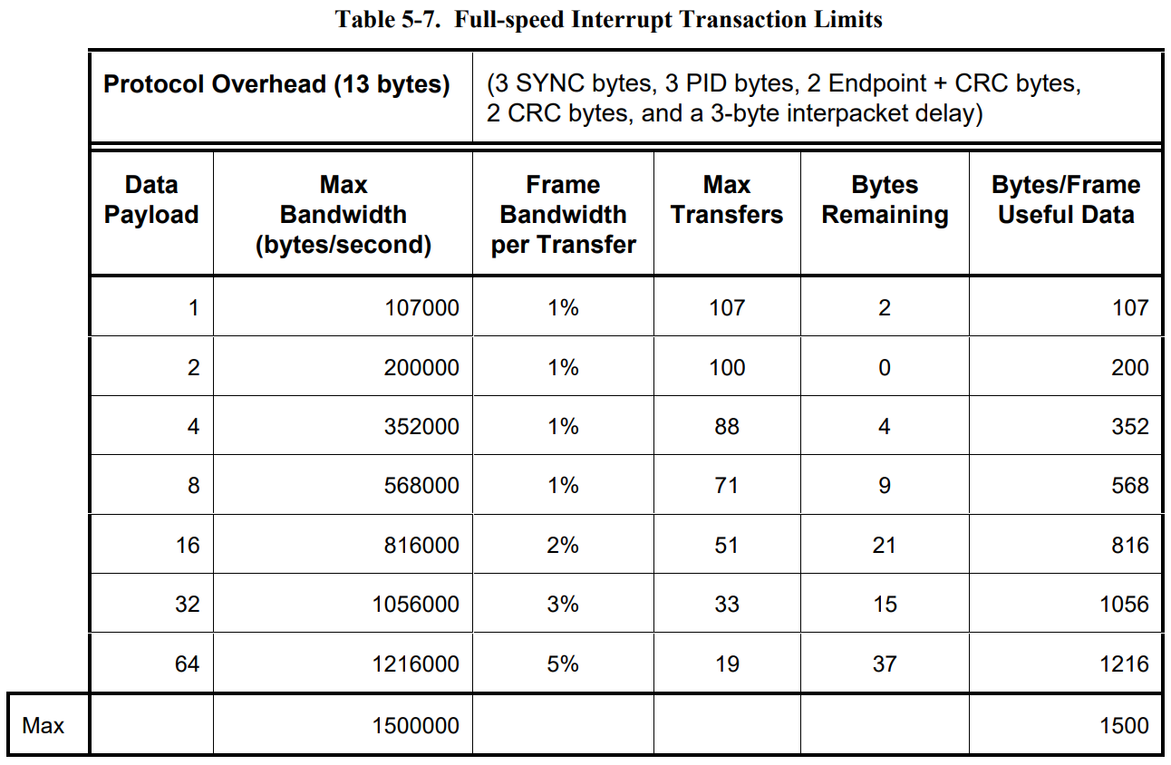
Protocol Layer Packet Formats: Interrupt Transactions
Interrupt Transfer Bus Access Constraints
High-speed endpoints can be allocated at most 80% of a microframe for periodic transfers.
The USB requires that no more than 90% of any frame be allocated for periodic (isochronous and interrupt) full-/low-speed transfers.

Slide 54
Protocol Layer Packet Formats: Interrupt Transactions
Interrupt Transfer Packet Size Constraints
The maximum allowable interrupt data payload size is 64 bytes or less for full-speed.
High-speed endpoints are allowed maximum data payload sizes up to 1024 bytes.
Low-speed devices are limited to eight bytes or less maximum data payload size.
All Host Controllers are required to support maximum data payload sizes from 0 to 64 bytes for full-speed interrupt endpoints, from 0 to 8 bytes for low-speed interrupt endpoints, and from 0 to 1024 bytes for highspeed interrupt endpoints.

Slide 55
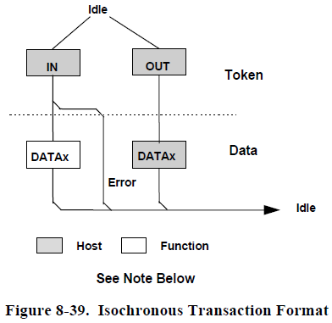
Protocol Layer Packet Formats: Isochronous Transactions
Isochronous transactions have a token and data phase, but no handshake phase, as shown in Figure 8-39.
The host issues either an IN or an OUT token followed by the data phase in which the endpoint (for INs) or the host (for OUTs) transmits data

Slide 56
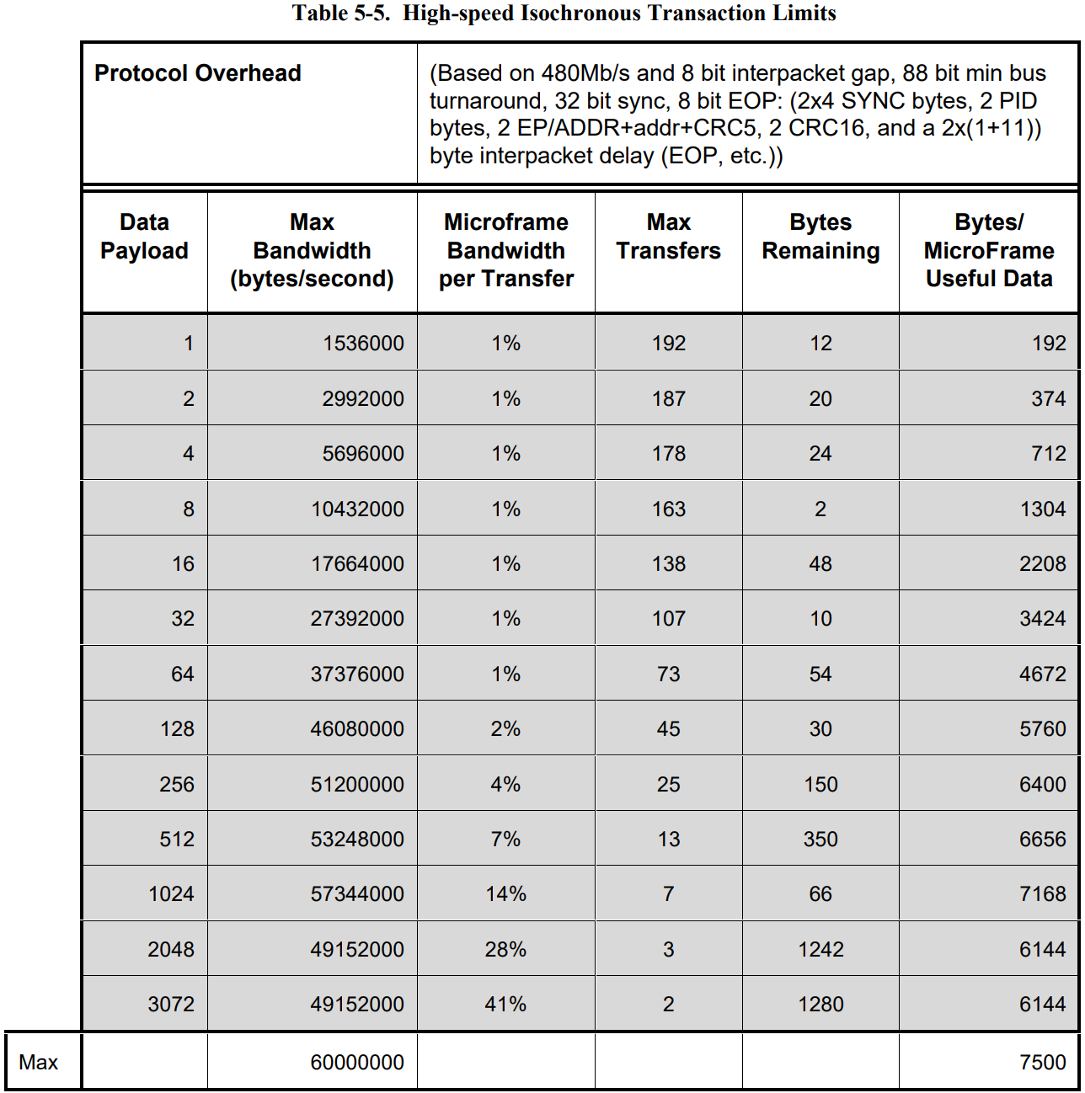

Protocol Layer Packet Formats: Isochronous Transactions
Isochronous Transfer Packet Size Constraints
Isochronous transfers can only be used by full-speed and high-speed devices.

Slide 57

Protocol Layer Packet Formats: Isochronous Transactions
Isochronous Transfer Bus Access Constraints
Isochronous transfers can only be used by full-speed and high-speed devices.
An isochronous endpoint must specify its required bus access period. Full-/high-speed endpoints must specify a desired period as ($2^{\text{bInterval}\text{−1}}$) x F, where bInterval is in the range one to (and including) 16 and F is 125 µs for high-speed and 1ms for full-speed.
The bus frequency and (micro)frame timing limit the maximum number of successful isochronous transactions within a (micro)frame for any USB system to less than 151 full-speed one-byte data payloads and less than 193 high-speed one-byte data payloads

Slide 58

Protocol Layer Data Toggle Synchronization and Retry - Initialization via SETUP Token
Control transfers use the SETUP token for initializing host and function sequence bits.
The numbers in the circles represent the transmitter and receiver sequence bits
The function must accept the data and return ACK
When the function accepts the transaction, it must set its sequence bit so that both the host’s and function’s sequence bits are equal to one at the end of the SETUP transaction

Slide 59

Protocol Layer Data Toggle Synchronization and Retry - Successful Data Transactions
Figure 8-45 shows the case where two successful transactions have occurred
The receiver toggles its sequence bit only if it receives a valid data packet and the packet’s data PID matches the current value of its sequence bit
The transmitter only toggles its sequence bit after it receives an ACK to a data packet.
During each transaction, the receiver compares the transmitter sequence bit (encoded in the data packet PID as either DATA0 or DATA1) with its receiver sequence bit.
If data cannot be accepted, the receiver must issue NAK and the sequence bits of both the transmitter and receiver remain unchanged.
If data can be accepted and the receiver’s sequence bit matches the PID sequence bit, then data is accepted and the sequence bit is toggled.
Two-phase transactions in which there is no data packet leave the transmitter and receiver sequence bits unchanged.

Slide 60

Protocol Layer Data Toggle Synchronization and Retry - Data Corrupted or Not Accepted
If data cannot be accepted or the received data packet is corrupted, the receiver will issue a NAK or STALL handshake, or timeout, depending on the circumstances, and the receiver will not toggle its sequence bit.
Any non-ACK handshake or timeout will generate similar retry behavior.
The transmitter, having not received an ACK handshake, will not toggle its sequence bit.
As a result, a failed data packet transaction leaves the transmitter’s and receiver’s sequence bits synchronized and untoggled.
The transaction will then be retried and, if successful, will cause both transmitter and receiver sequence bits to toggle.

Slide 61

Protocol Layer Data Toggle Synchronization and Retry - Corrupted ACK Handshake
A lost or corrupted ACK handshake can lead to a temporary loss of synchronization between transmitter and receiver as shown in Figure 8-47.
At the end of transaction i, there is a temporary loss of coherency between transmitter and receiver, cause the mismatch between their respective sequence bits.
On the next transaction, the transmitter will resend the previous data using the previous DATA0 PID.
The receiver’s sequence bit and the data PID will not match, it discards the incoming data packet and does not toggle its sequence bit.
The receiver then issues ACK, which causes the transmitter to regard the retried transaction as successful.
Receipt of ACK causes the transmitter to toggle its sequence bit. At the beginning of transaction i+1, the sequence bits have toggled and are again synchronized

Slide 62

Protocol Layer Error Detection and Recovery: Packet Error Categories
With the exception of the SOF token, any packet that is received corrupted causes the receiver to ignore it and discard any data or other field information that came with the packet.
Table 8-8 lists error detection mechanisms, the types of packets to which they apply, and the appropriate packet receiver response.

Slide 63

Protocol Layer Error Detection and Recovery: Bus Turn-around Timing
As a consequence of this method of error reporting, the host and USB function need to keep track of how much time has elapsed from when the transmitter completes sending a packet until it begins to receive a response packet.
This time is referred to as the bus turn-around time. Devices and hosts require turn-around timers to measure this time.
For full-/low-speed transactions, the timer starts counting on the SE0-to-‘J’ transition of the EOP strobe and stops counting when the Idle-to-‘K’ SOP transition is detected.
For high-speed transactions, the timer starts counting when the data lines return to the squelch level and stops counting when the data lines leave the squelch level.

Slide 64
Providing
electrical power

Slide 65
Providing electrical power Power Distribution and Power Management
The Power specification covers two aspects of power:
Power Distribution: Power distribution over the USB deals with the issues of how USB devices consume power provided by the host over the USB
Each USB segment provides a limited amount of power over the cable. The host supplies power for use by USB devices that are directly connected. In addition, any USB device may have its own power supply. USB devices that rely totally on power from the cable are called bus-powered devices. In contrast, those that have an alternate source of power are called self-powered devices. A hub also supplies power for its connected USB devices.
Power Management: Power management deals with how the USB System Software and devices fit into the host-based power management system
A USB host may have a power management system that is independent of the USB. The USB System Software interacts with the host’s power management system to handle system power events such as suspend or resume. Additionally, USB devices typically implement additional power management features that allow them to be power managed by system software.
The power distribution and power management features of the USB allow it to be designed into power sensitive systems such as battery-based notebook computers

Slide 66
Providing electrical power Power Management
Power Budgeting:
USB bus power is a limited resource. If the power requirements of a particular configuration exceed the power available to the device, Host Software shall not select that configuration.
USB devices shall limit the power they consume from VBUS to one unit load or less until configured.
Depending on the power capabilities of the port to which the device is attached, a USB device may be able to draw up to five unit loads from VBUS after configuration.
Remote Wakeup:
Remote wakeup allows a suspended USB device to signal a host that may also be suspended.
A USB device reports its ability to support remote wakeup in a configuration descriptor. If a device supports remote wakeup, it must also allow the capability to be enabled and disabled using the standard USB requests.
Remote wakeup is accomplished using electrical signaling.

Slide 67
Providing electrical power POWER Distribution
The power source and sink requirements of different device classes can be simplified with the introduction of the concept of a unit load. A unit load is defined to be 100 mA. The number of unit loads a device can draw is an absolute maximum, not an average over time. A device may be either low-power at one unit load or high power, consuming up to five unit loads. All devices default to low-power. The transition to high-power is under software control.
The USB supports a range of power sourcing and power consuming agents; these include the following:
Root port hubs: Are directly attached to the USB Host Controller. Hub power is derived from the same source as the Host Controller. Systems that obtain operating power externally, either AC or DC, must supply at least five unit loads to each port. Such ports are called high-power ports. Battery-powered systems may supply either one or five-unit loads. Ports that can supply only one unit load are termed low power ports.
Bus-powered hubs: Draw all of their power for any internal functions and downstream facing ports from VBUS on the hub’s upstream facing port. Bus-powered hubs may only draw up to one unit load upon power-up and five unit loads after configuration. The configuration power is split between allocations to the hub, any non-removable functions and the external ports. External ports in a bus-powered hub can supply only one unit load per port regardless of the current draw on the other ports of that hub. The hub must be able to supply this port current when the hub is in the Active or Suspend state

Slide 68
Providing electrical power POWER Distribution
Self-powered hubs: Power for the internal functions and downstream facing ports does not come from VBUS. However, the USB interface of the hub may draw up to one unit load from VBUS on its upstream facing port to allow the interface to function when the remainder of the hub is powered down. Hubs that obtain operating power externally (from the USB) must supply five unit loads to each port. Battery powered hubs may supply either one or five unit loads per port.
Low-power bus-powered functions: All power to these devices comes from VBUS. They may draw no more than one unit load at any time.
High-power bus-powered functions: All power to these devices comes from VBUS. They must draw no more than one unit load upon power-up and may draw up to five unit loads after being configured.
Self-powered functions: May draw up to one unit load from VBUS to allow the USB interface to function when the remainder of the function is powered down. All other power comes from an external (to the USB) source.

Slide 69
Providing electrical power Over-current Protection
Over-current Protection
The host and all self-powered hubs must implement over-current protection for safety reasons, and the hub must have a way to detect the over-current condition and report it to the USB software. Should the aggregate current drawn by a gang of downstream facing ports exceed a preset value, the over-current protection circuit removes or reduces power from all affected downstream facing ports. The over-current condition is reported through the hub to Host Controller. The preset value cannot exceed 5.0 A and must be sufficiently above the maximum allowable port current such that transient currents do not trip the over-current protector. The over-current limiting mechanism must be resettable without user mechanical intervention.

Slide 70

Providing electrical power Voltage Drop Budget
The voltage drop budget is determined from the following:
The voltage supplied by high-powered hub ports is 4.75 V to 5.25 V, low-powered hub ports is 4.4 V to 5.25 V.
Bus-powered hubs can have a maximum drop of 350 mV.
The maximum voltage drop between the A-series plug and B-series plug on VBUS is 125 mV (VBUSD).
The maximum voltage drop for all cables between upstream and downstream on GND is 125 mV (VGNDD).
All hubs and functions must be able to provide configuration information with as little as 4.40 V at the connector end of their upstream cables. Only low-power functions need to be operational with this minimum voltage.
Functions drawing more than one unit load must operate with a 4.75 V minimum input voltage at the connector end of their upstream cables.

Slide 71

Providing electrical power Power Control During Suspend/Resume
Suspend current is a function of unit load allocation. All USB devices initially default to low-power. Lowpower devices or high-power devices operating at low-power are limited to 500 µA of suspend current. If the device is configured for high-power and enabled as a remote wakeup source, it may draw up to 2.5 mA during suspend.
When devices wakeup, either by themselves (remote wakeup) or by seeing resume signaling, they must limit the inrush current on VBUS. The target maximum droop in the hub VBUS is 330 mV. The device must have sufficient on-board bypass capacitance or a controlled power-on sequence such that the current drawn from the hub does not exceed the maximum current capability of the port at any time while the device is waking up

Slide 72
Providing electrical power Dynamic Attach and Detach
The act of plugging or unplugging a hub or function must not affect the functionality of another device on other segments of the network. Unplugging a function will stop the transaction between that function and the host. However, the hub to which this function was attached will recover from this condition and will alert the host that the port has been disconnected.
Inrush Current Limiting
When a function or hub is plugged into the network, it has a certain amount of on-board capacitance between VBUS and ground.
Inrush currents can also occur when a high-power function is switched into its high-power mode. This problem must be solved by limiting the inrush current and by providing sufficient capacitance in each hub.
Dynamic Detach
When a device is detached from the network with power flowing in the cable, the inductance of the cable will cause a large flyback voltage to occur on the open end of the device cable.
Proper bypass measures on the hub ports will suppress any coupled noise. The frequency range of this noise is inversely dependent on the length of the cable, to a maximum of 60 MHz for a one-meter cable.

Slide 73
USB Transaction Examples

Slide 74

Bulk/Control OUT and SET UP
Normal cases
No buffer(on hub) available cases
CS(Complete-split transaction) earlier cases
Device busy cases
Device stall cases
Refer:APPENDIX A TRANSACTION EXAMPLES of Universal Serial Bus Specification Revision 2.0

Slide 75

Bulk/Control OUT and SET UP
Normal cases
No buffer(on hub) available cases
CS(Complete-split transaction) earlier cases
Device busy cases
Device stall cases

Slide 76

Bulk/Control OUT and SET UP
Normal cases
No buffer(on hub) available cases
CS(Complete-split transaction) earlier cases
Device busy cases
Device stall cases

Slide 77

Bulk/Control IN
Normal cases
No buffer(on hub) available cases
CS(Complete-split transaction) earlier cases
Device busy cases
Device stall cases

Slide 78

Bulk/Control IN
Normal cases
No buffer(on hub) available cases
CS(Complete-split transaction) earlier cases
Device busy cases
Device stall cases

Slide 79

Interrupt out
Normal cases
Searching
CS(Complete-split transaction) earlier cases
Abort and Free cases
FS/LS transaction error cases
Device busy cases
Device stall cases

Slide 80

Interrupt out
Normal cases
Searching
CS(Complete-split transaction) earlier cases
Abort and Free cases
FS/LS transaction error cases
Device busy cases
Device stall cases

Slide 81

Interrupt out
Normal cases
Searching
CS(Complete-split transaction) earlier cases
Abort and Free cases
FS/LS transaction error cases
Device busy cases
Device stall cases

Slide 82

Interrupt in
Normal cases
Searching
CS(Complete-split transaction) earlier cases
Abort and Free cases
FS/LS transaction error cases
Device busy cases
Device stall cases

Slide 83

Interrupt in
Normal cases
Searching
CS(Complete-split transaction) earlier cases
Abort and Free cases
FS/LS transaction error cases
Device busy cases
Device stall cases

Slide 84

Interrupt in
Normal cases
Searching
CS(Complete-split transaction) earlier cases
Abort and Free cases
FS/LS transaction error cases
Device busy cases
Device stall cases

Slide 85

Interrupt in
Normal cases
Searching
CS(Complete-split transaction) earlier cases
Abort and Free cases
FS/LS transaction error cases
Device busy cases
Device stall cases

Slide 86

Interrupt in
Normal cases
Searching
CS(Complete-split transaction) earlier cases
Abort and Free cases
FS/LS transaction error cases
Device busy cases
Device stall cases

Slide 87

Isochronous OUT Split-transaction
Normal: small payload (<=188)
Normal: large payload (> 188)
HS SSPLIT-all corrupted
HS OUT corrupted
HS DATA0 corrupted (small payload)
HS SSPLIT-begin corrupted
HS OUT after the HS SSPLIT-begin is corrupted
HS DATA0 corrupted (large payload)
HS SSPLIT-mid or OUT or DATA0 corrupted

Slide 88

Isochronous OUT Split-transaction
Normal: small payload (<=188)
Normal: large payload (> 188)
HS SSPLIT-all corrupted
HS OUT corrupted
HS DATA0 corrupted (small payload)
HS SSPLIT-begin corrupted
HS OUT after the HS SSPLIT-begin is corrupted
HS DATA0 corrupted (large payload)
HS SSPLIT-mid or OUT or DATA0 corrupted

Slide 89
reference
USB 2.0 specifications: https://www.usb.org/document-library/usb-20-specification
Simple explanation about USB protocol: https://www.usbmadesimple.co.uk/index.html

Slide 90
Renesas.com

